Slide 1
The Pyramid
Team Pyramid

Slide 2
Team
Tom Rose
DeAndre Chilton Jr.

Slide 3
Problem
Our goal for this project was to create a moderately complex, test-based game using Python.

Slide 4
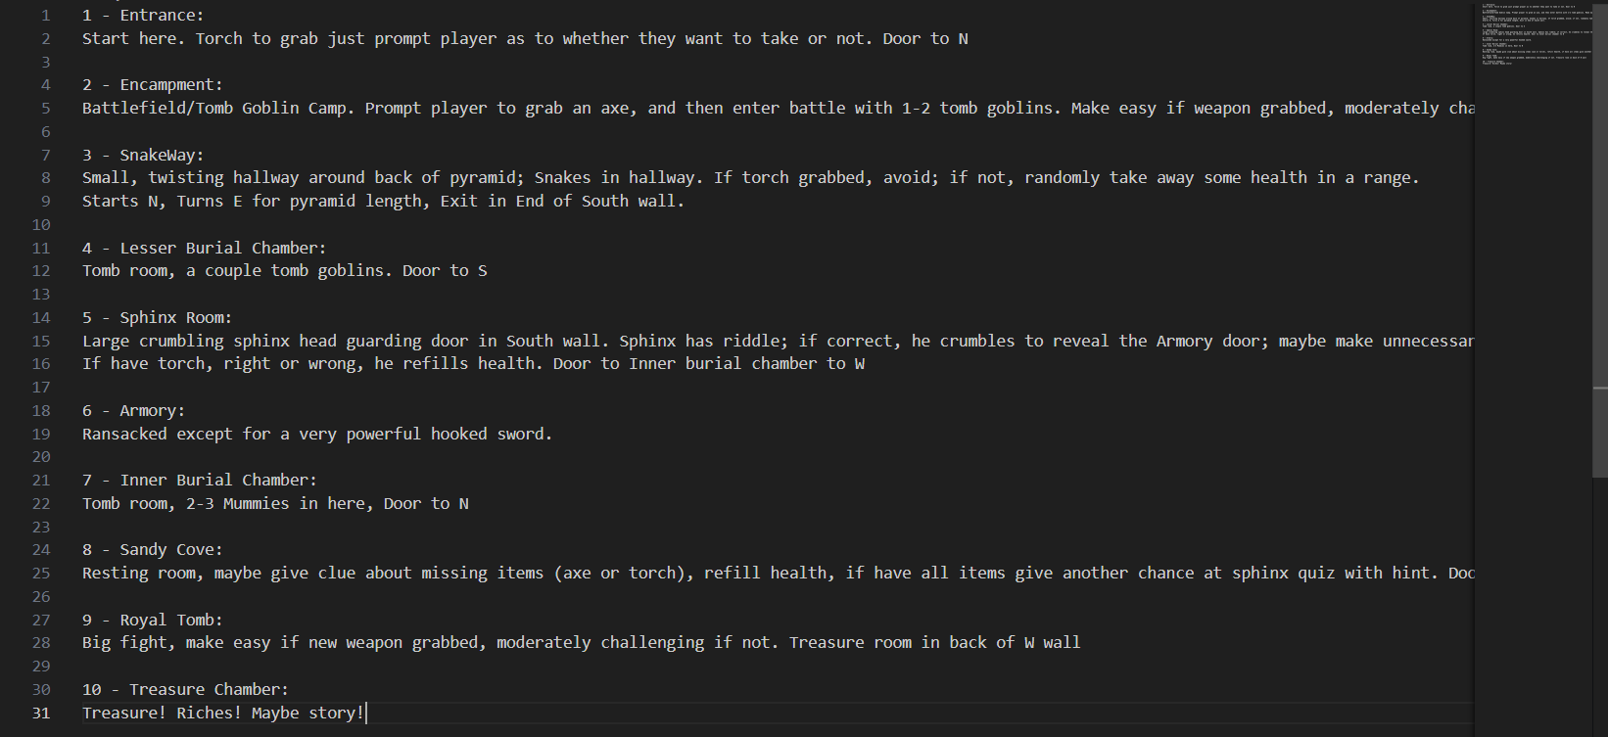
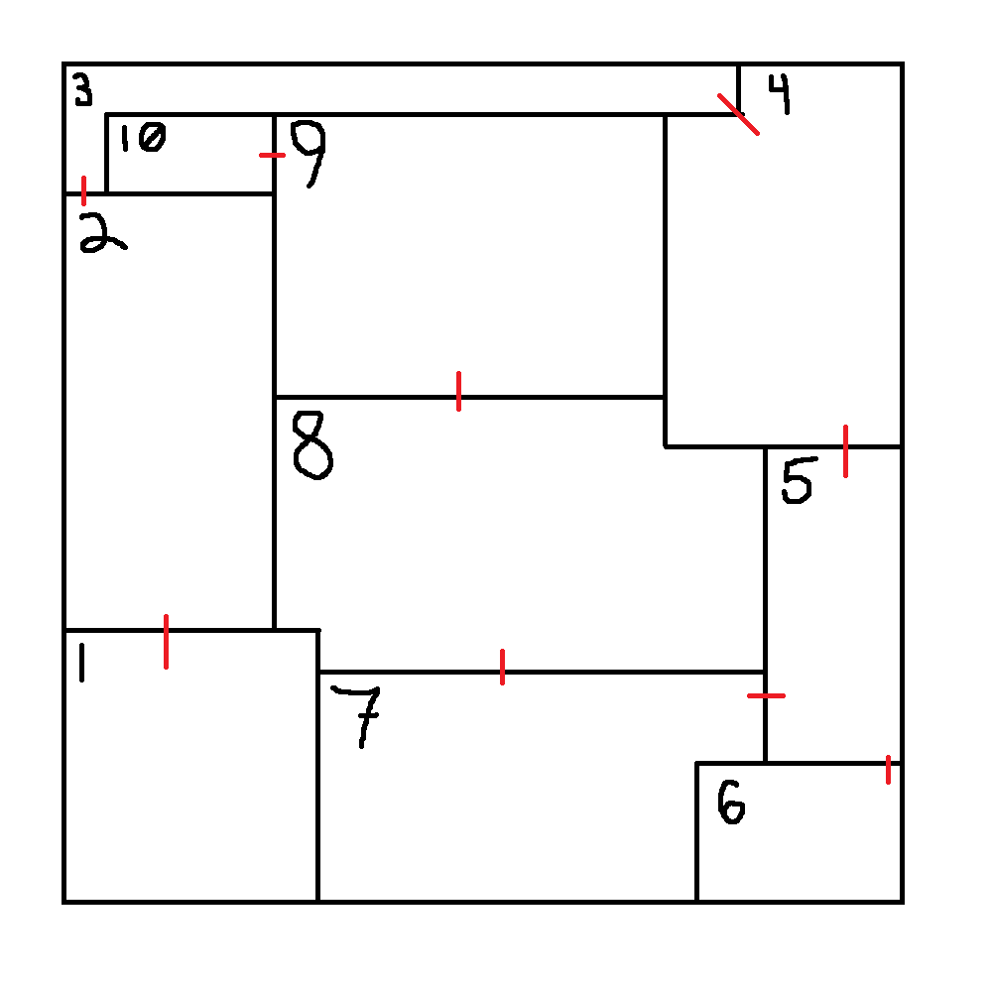
Solution
Using Visual Studio Code and Github Desktop, we were able to plan and construct a game that includes 10 different rooms, each bringing something new to the user.

Slide 5
Demo

Slide 6
Lessons Learned
It would’ve been to our benefit to form a project architecture before beginning to code.
Unit testing relies crucially on the file that it’s importing functions from so it’s important to have everything functional.

Slide 7
Issues/Bugs Known
In our testing, we found that our test cases wouldn’t yield any results (pass or fail) when running the test file code. The reason for this is something we haven’t been able to attribute to one specific thing, however this issue doesn’t break any of the code’s functionality.

Slide 8
Future Versions
Plans
Troubleshooting bugs, such as an issue in the snakeway that could be resolved by separating the functionality of checking for torch and capturing movement, and an issue that lets a player bounce back between the sphinx and the sandy cove, failing and unlocking the riddle.

Slide 9
References
https://www.doxygen.nl/manual/docblocks.html
https://en.wikipedia.org/wiki/Isis

Slide 10
Thank you!
Any questions?

